Slide 1
House sensors
LOLA

Slide 2
The team
Arron – Taking Computer Science an a A-Level, does programming as a hobby.
Lakshmi – finished masters in communication engineering, looking to start a career in software development.
Liam – Just finished university, app development, web development and server side web development.
Ollie – DJ started looking into development as a hobby.

Slide 3
The task
To build a series of sensors that monitor temperature, humidity and water usage; to be placed in a home, to transmit data to a central server to be accessed via a website and mobile applications.

Slide 4
What did we Accomplish
2 working humidity and temperature sensors.
One working water meter sensor.
Cloud hosted server.
Responsive website.
iOS Application.
Android Application.

Slide 5
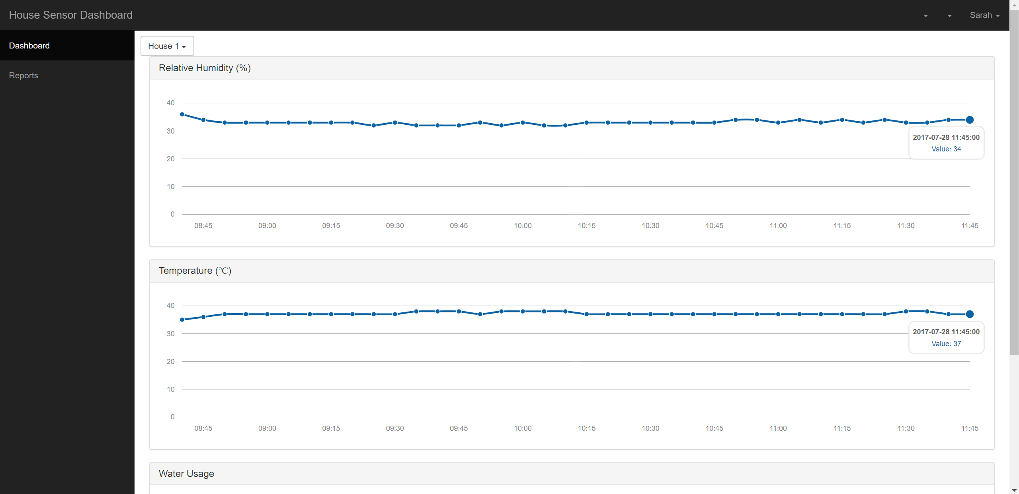
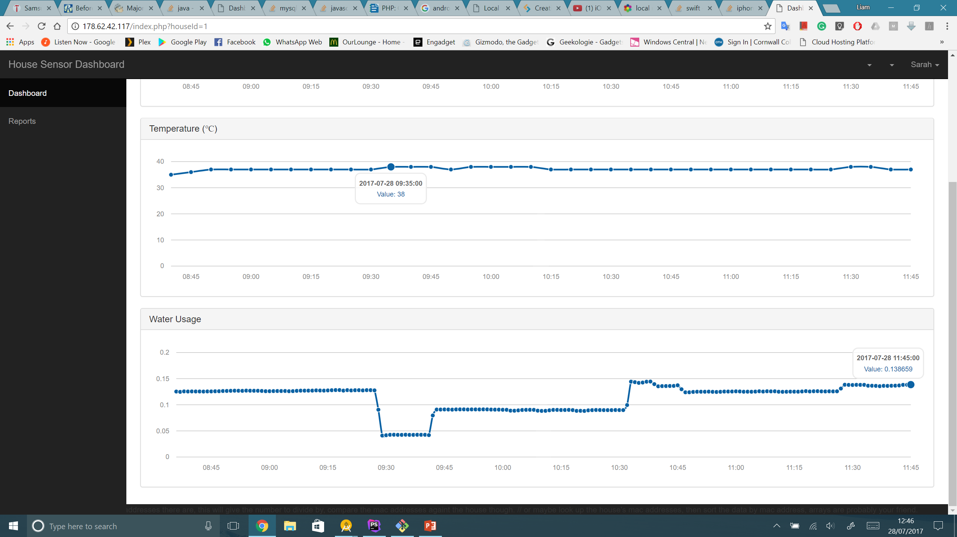
Website

Slide 6
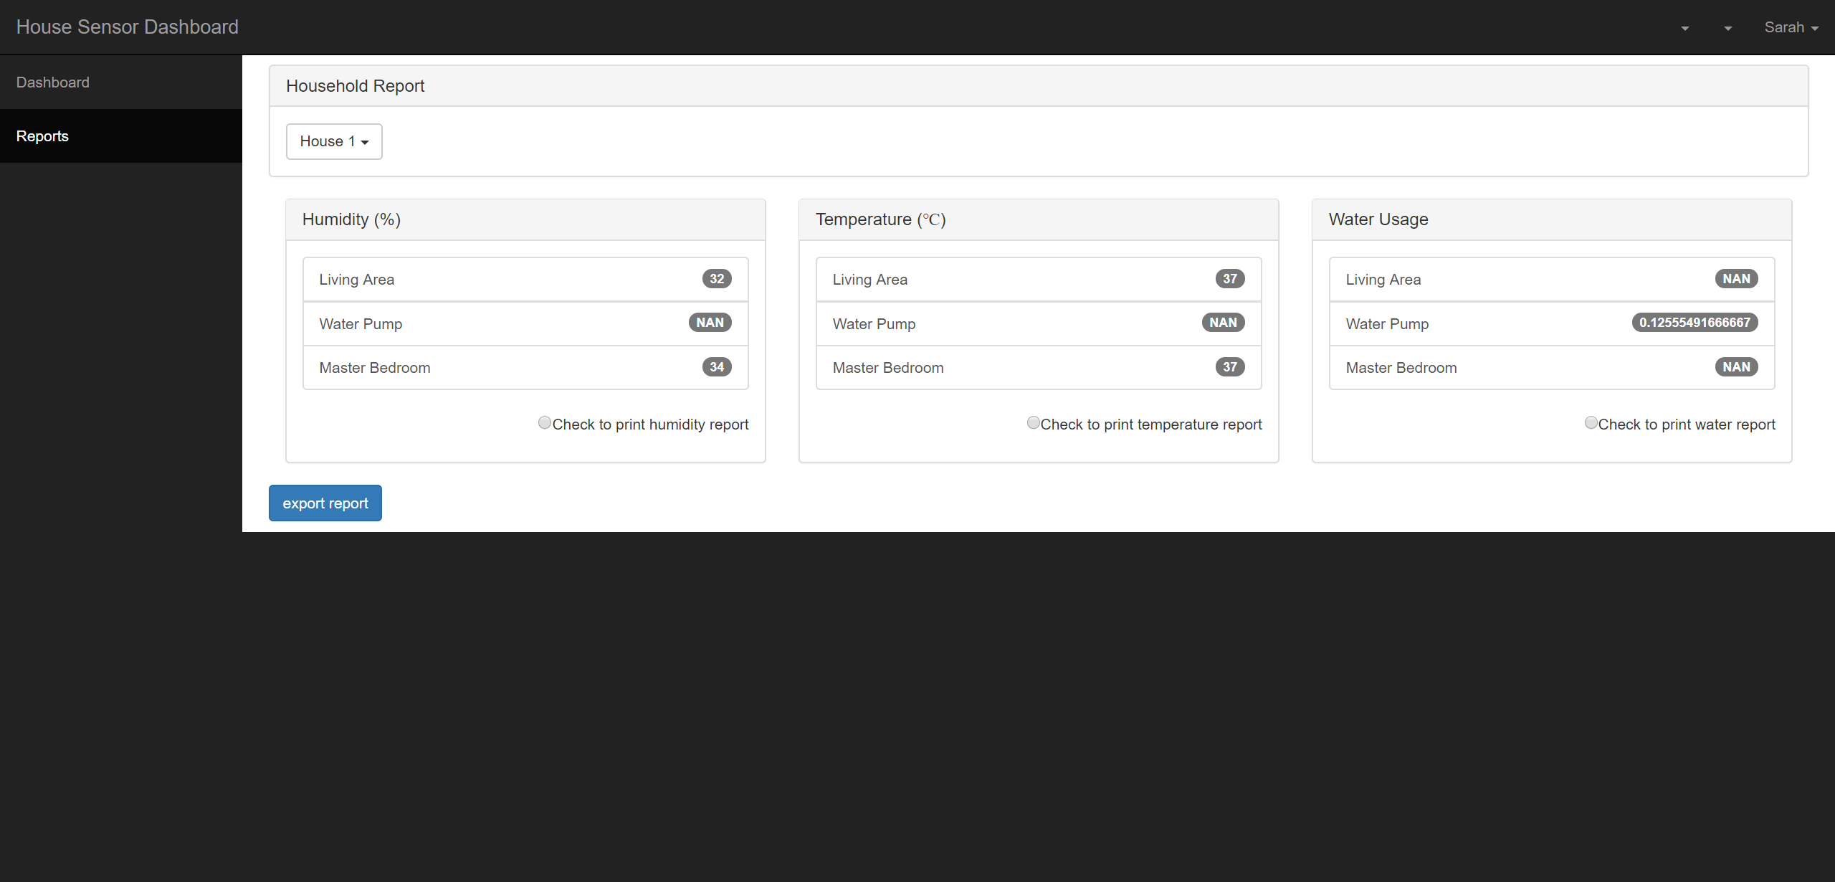

Slide 7
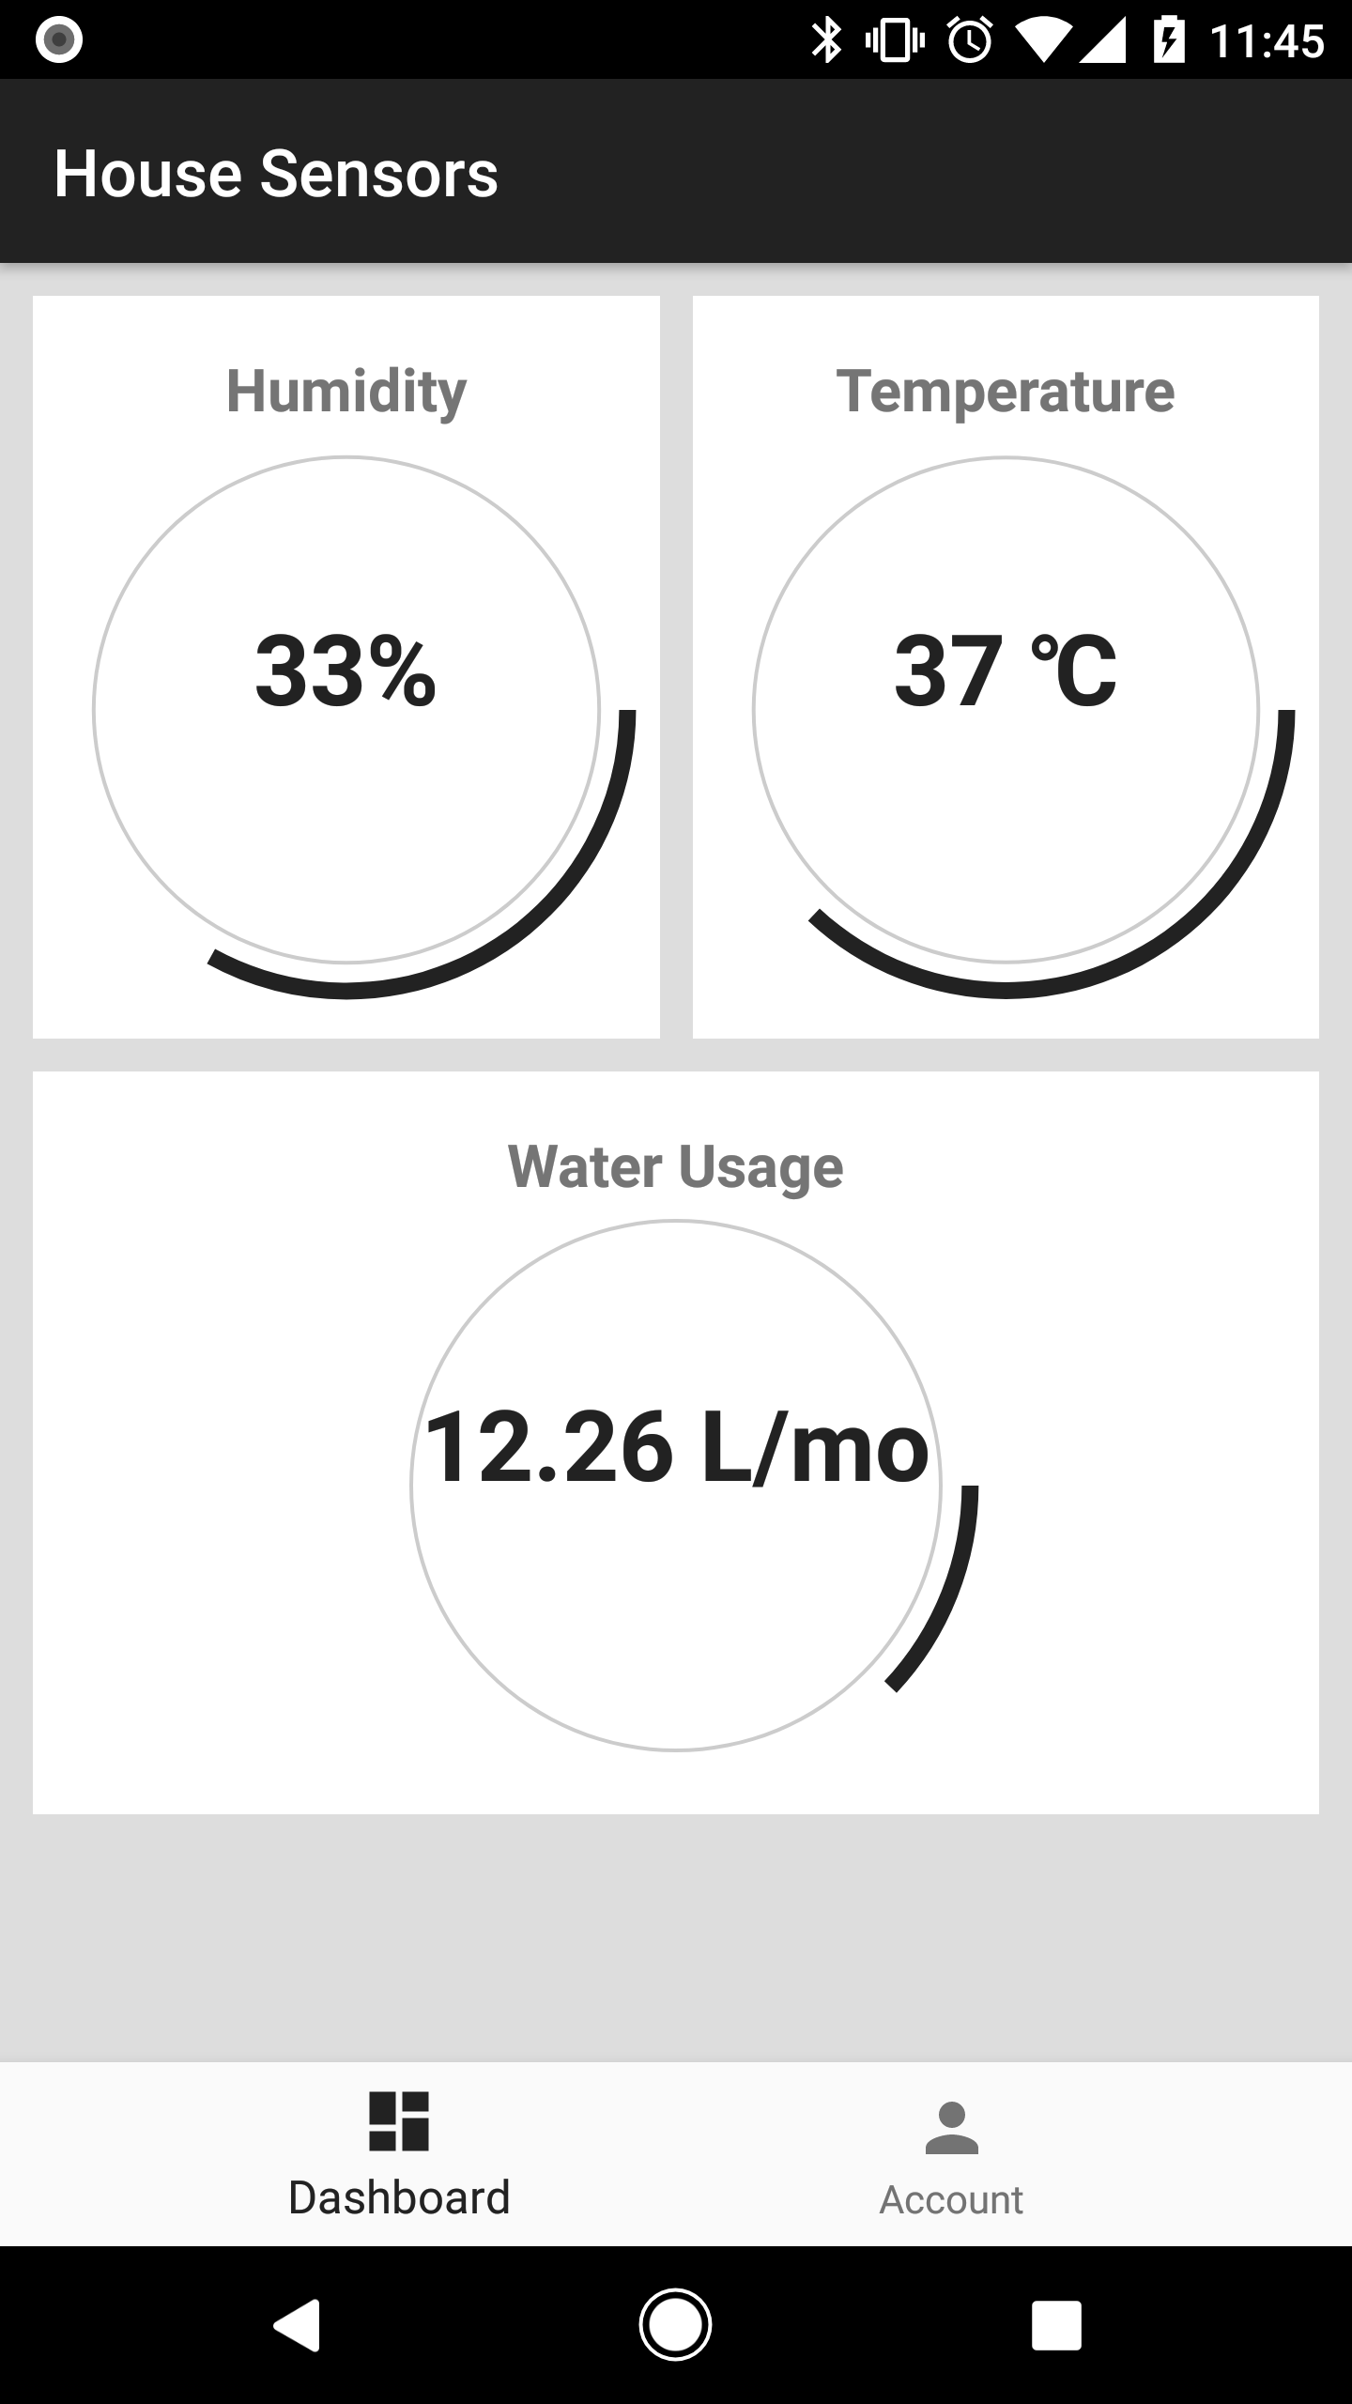
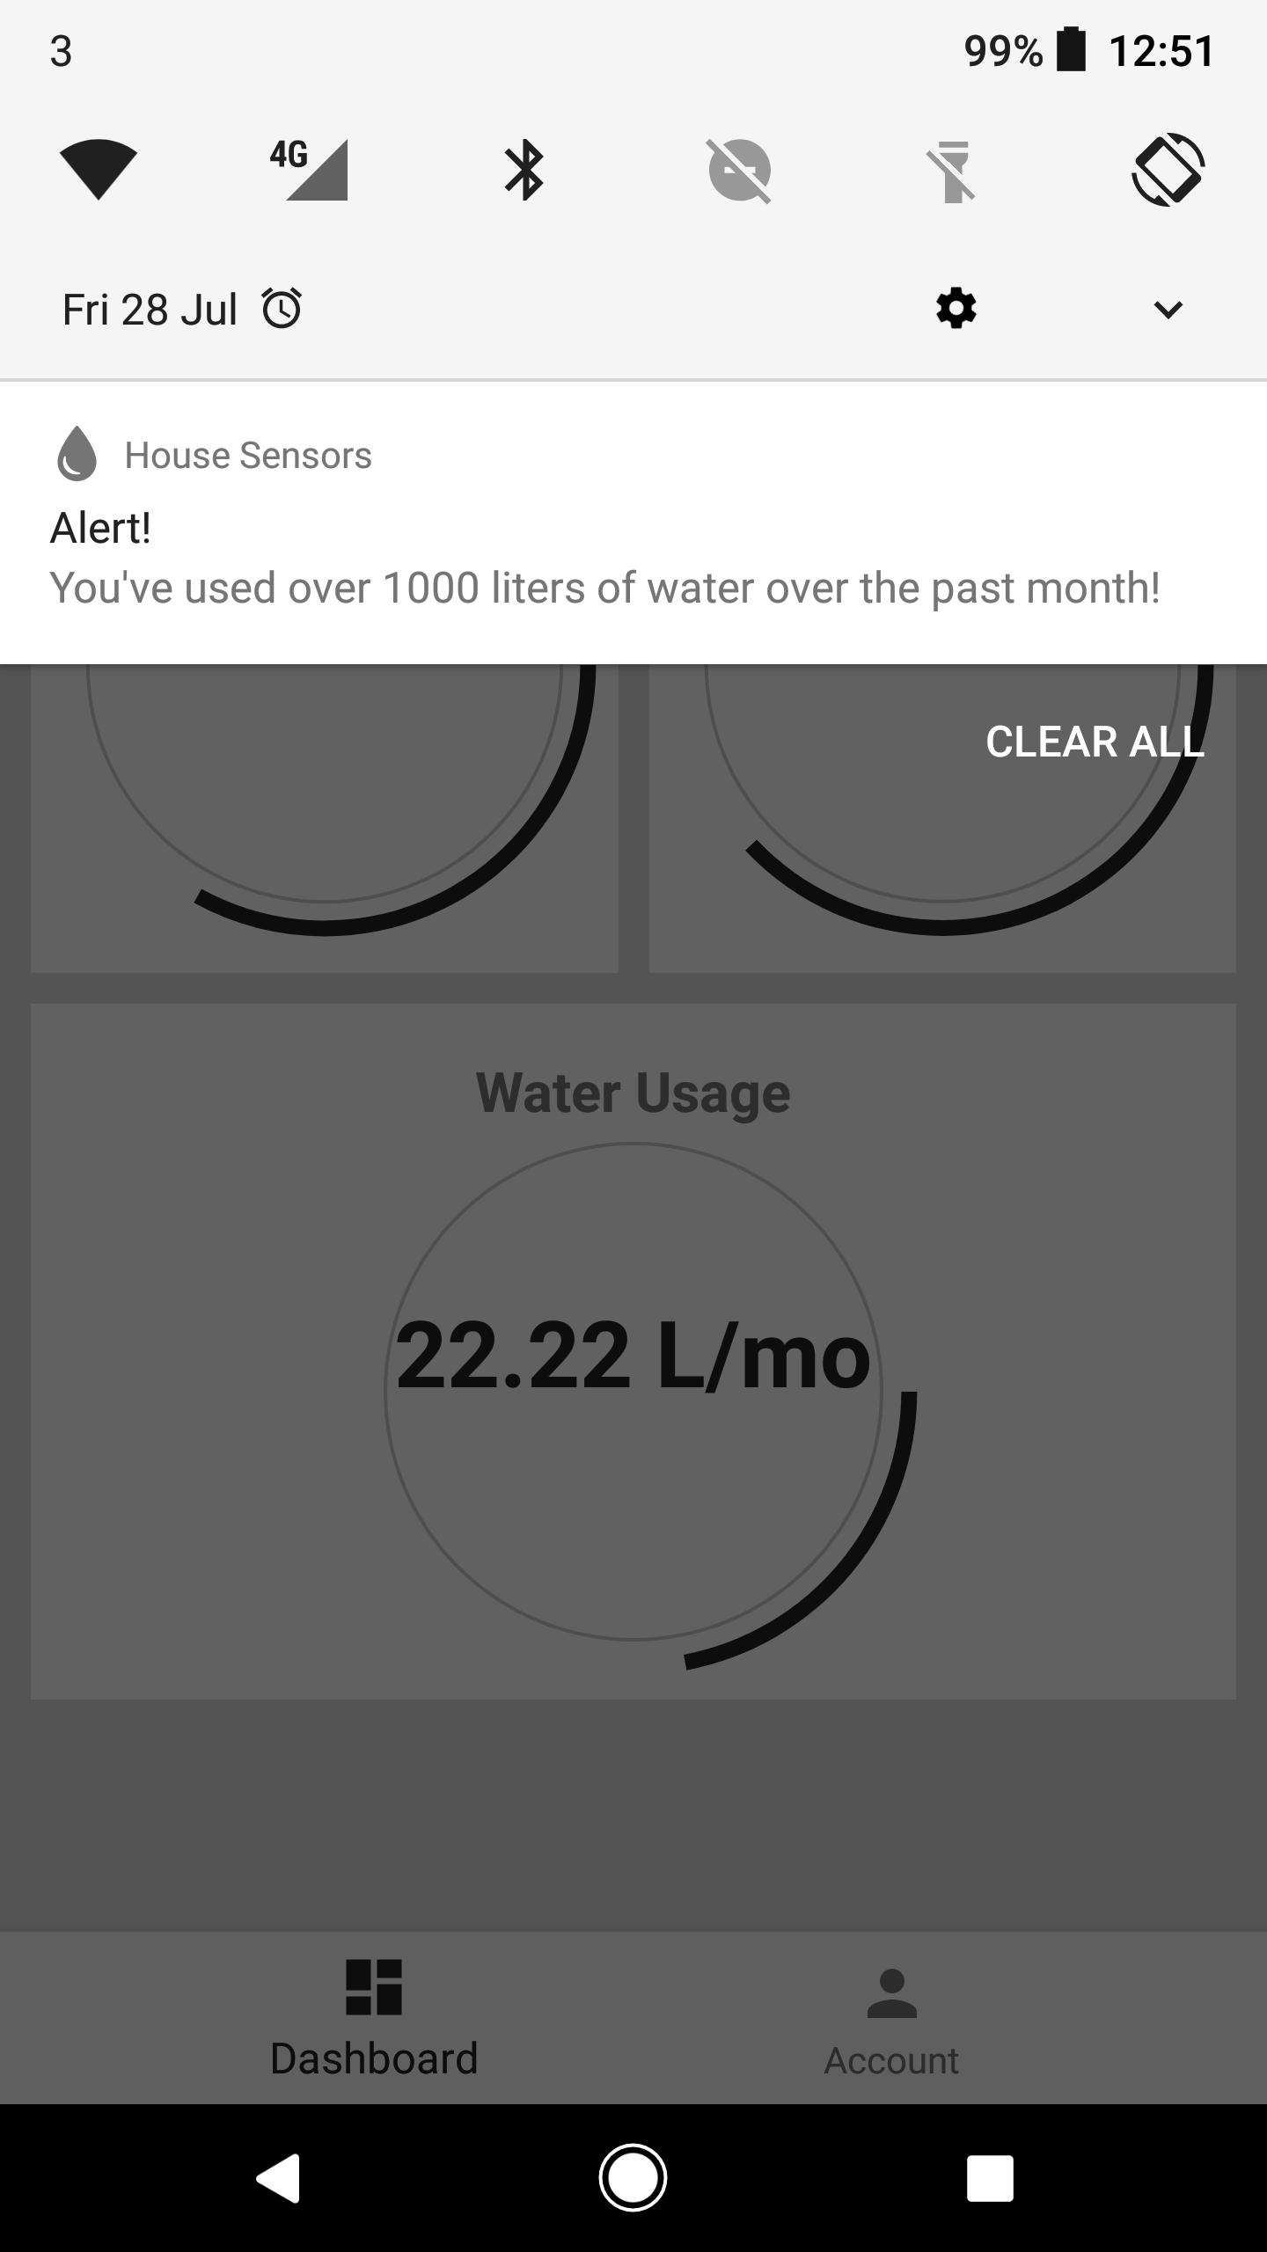
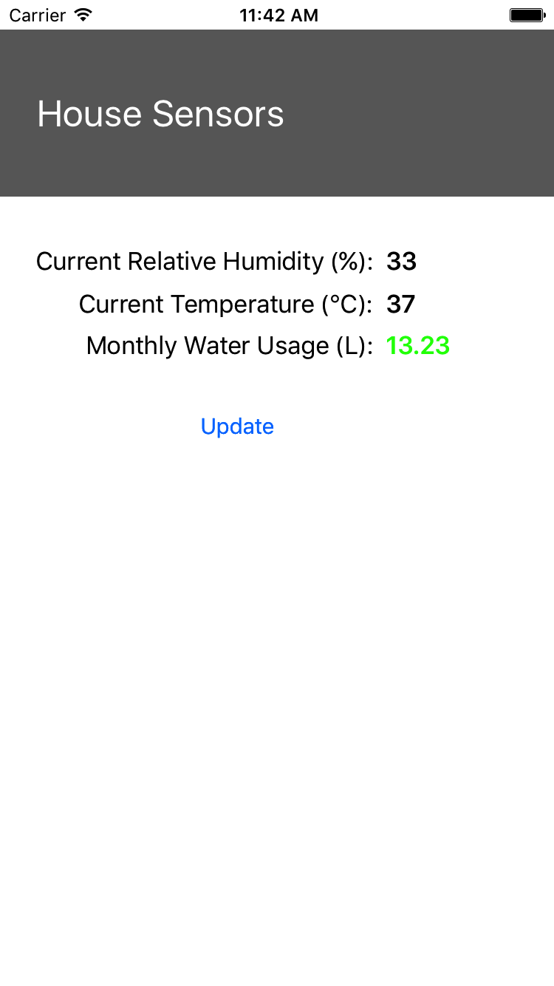
Applications

Slide 8
Total resources used
3/4 people.
10 days.

Slide 9
What’s next?

Slide 10
Potential
Could be used to monitor usage in houses to allow for a more echo friendly footprint.

Slide 11
limitations
Use of more specialised hardware would make the project easier.

Slide 12
Further Development
Air quality sensors.
User account based login system for the website.

Slide 13
Features

Slide 14
Hardware
Sense hat board that senses temperature and humidity.
A water meter that helps to find the water usage.
Raspberry pi

Slide 15
UI/UX
Native application design to fit with the operating system its being run on.

Slide 16
What we need

Slide 17
Requirements
People
Equipment
Skills

